Slide 1
Mars Lander Assignment IA Summer
Mary Liu
yl920

Slide 2
Assignment 1
Write a program to execute the Euler and Verlet algorithms for the mass on the spring, and plot the trajectories of the dynamical variables as functions of time. Convince yourself that the programs work by solving the equation of motion analytically. To get you started, a Python script for the Euler method is provided on the Moodle course page.
Investigate the numerical solution for various different values of the time step ∆t. Compare the performance of the two algorithms over several thousand oscillations, both with each other and also with the exact analytical solution. For example, if you take m = k = v0 = 1 and calculate the trajectory from t = 0 to t = 1000, you should find that the Verlet integrator is stable for ∆t = 1 but not for ∆t = 2.
Find, by trial and error, the critical value of ∆t for the Verlet case, above which it becomes unstable. The first order Euler integrator is never completely stable, but gets better for smaller values of ∆t.

Slide 3
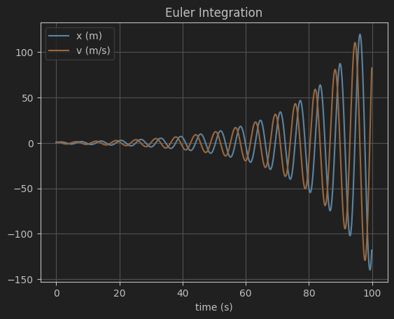
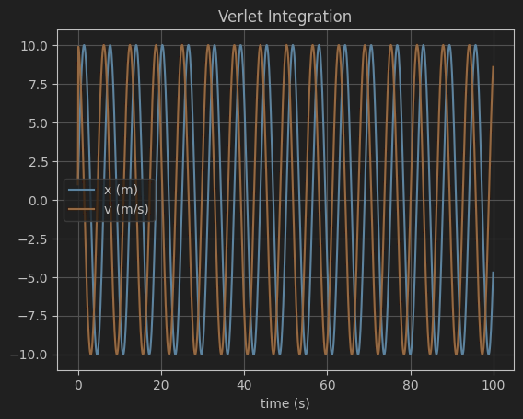
1.1
Both t_max=100, dt=0.1

Slide 4
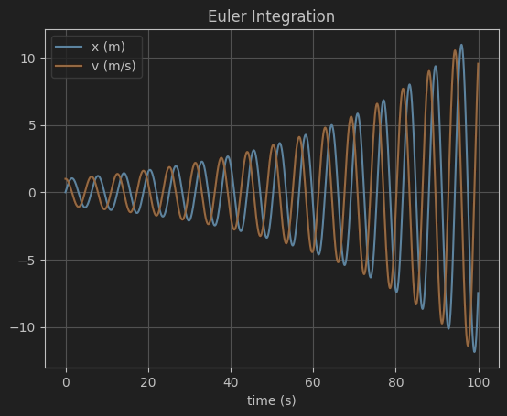
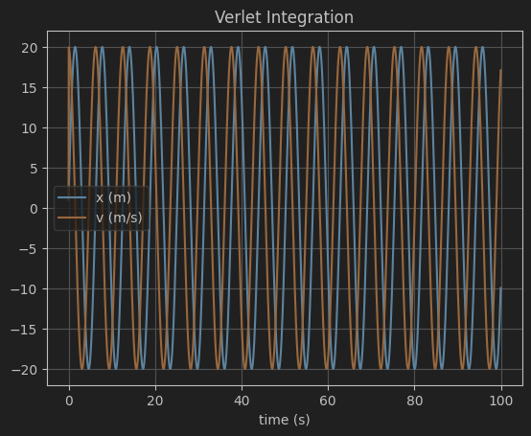
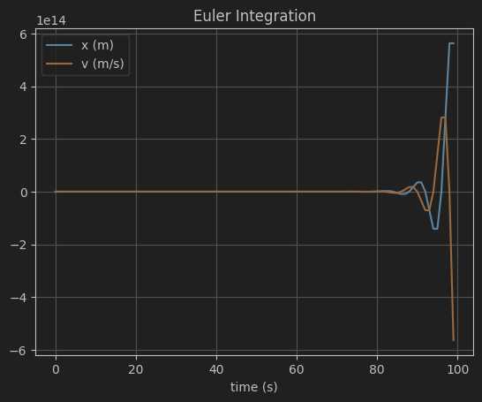
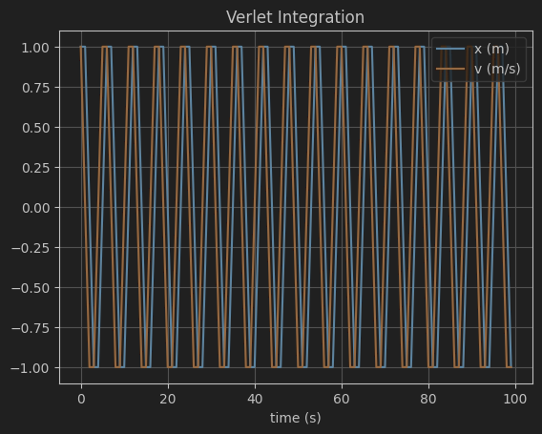
1.2
T_max=100, dt=0.05
dt = 1

Slide 5
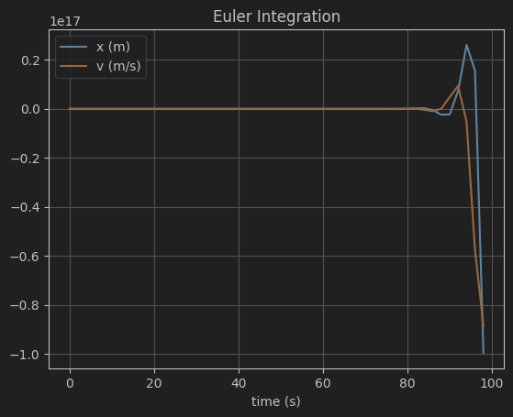
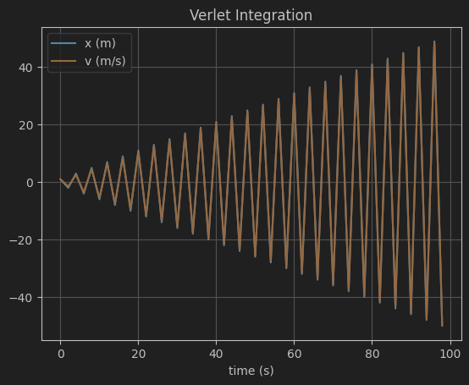
Dt = 2

Slide 6
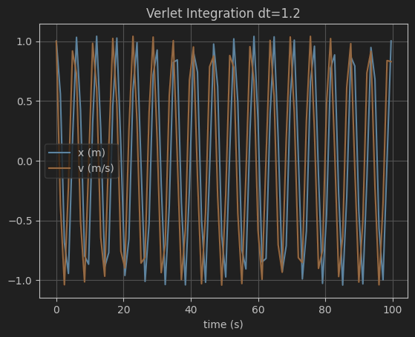
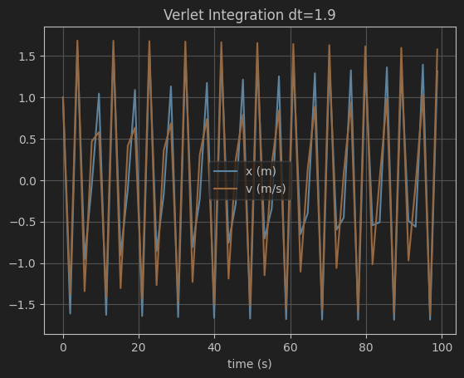
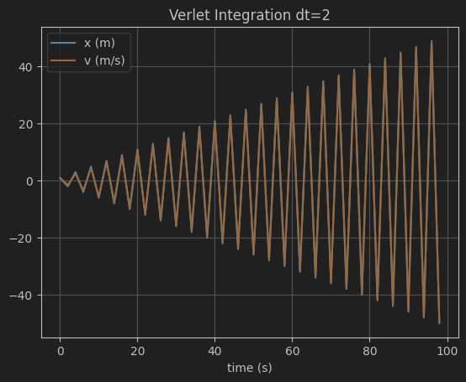
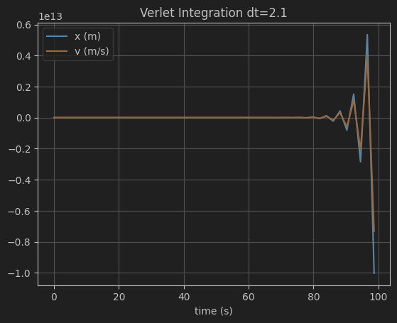
1.3
Critical value of dt=2

Slide 7
Assignment 2
After modifying your Euler and Verlet programs as described above, check them by simulating: 1. Straight down descent 3. Elliptical orbit 2. Circular orbit 4. Hyperbolic escape For simplicity, take the centre of the planet to be the origin of the coordinate system, and the direction of the initial velocity to be perpendicular to the initial position vector of the body for Scenarios 2–4. Use zero initial velocity for Scenario 1. You will obtain different orbits by adjusting the magnitude of the initial velocity. It might help if you first calculate the required speed for a circular orbit, and the escape velocity (use the principle of conservation of energy). For Scenario 1, plot altitude as a function of time. For Scenarios 2–4, plot the trajectory in the orbital plane.

Slide 8
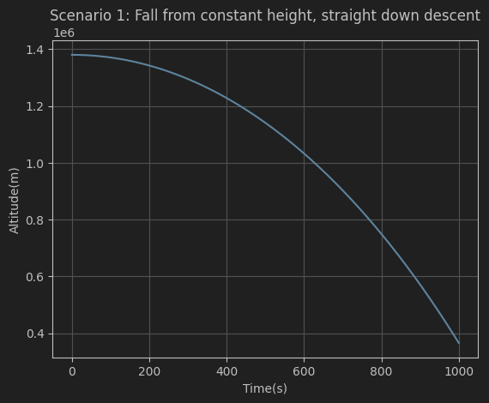
Scenario 1:

Slide 9
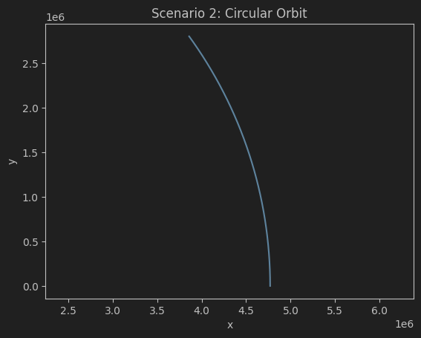
Trajectory for Scenario 2:

Slide 10
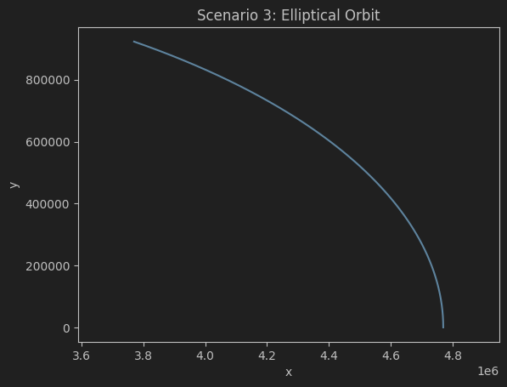
Trajectory for Scenario 3:

Slide 11
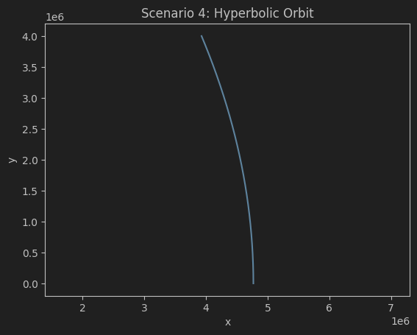
Trajectory for Scenario 4:

Slide 12
Assignment 3: familiarisation with C++
Read through Appendix A for a quick introduction to C++. This includes a worked C++ example of an Euler simulation of a mass on a spring, which you can compare and contrast with the Python equivalent in Assignment 1.
Measure the execution time of the Python and C++ simulations, both with and without C++ compiler optimizations. Modify the provided C++ code to perform Verlet instead of Euler integration.

